Slide 1
Human Body Structure & Function

Slide 2
Purpose of Unit
Designed to enable learners to understand key aspects of the human body & its physiological processes.
Learners also develop practical skills in techniques relevant to physiology.
Provides the underpinning knowledge & skills to enable progression to further study of physiological processes.

Slide 3
Course Content
Physiological control of the human body by nervous and endocrine systems.
Physiology of the musculoskeletal system.
Physiology of the cardiovascular system.
Dual role of the respiratory & excretory systems in maintaining homeostasis.
Physiology of the digestive system.
Perform practical experiments related to physiology.

Slide 4
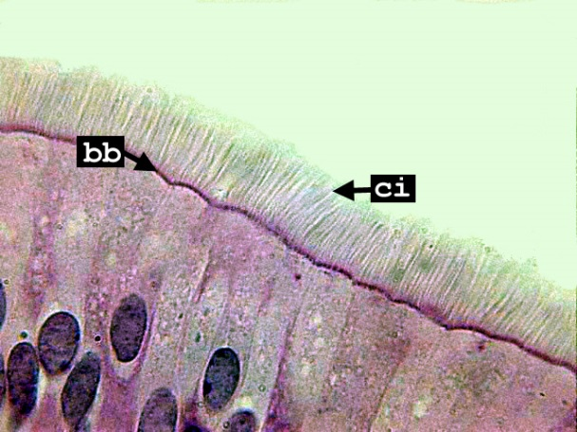
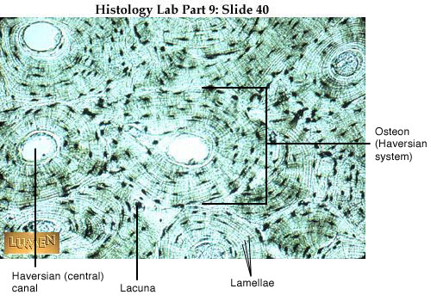
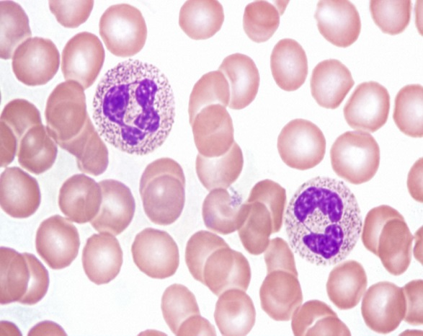
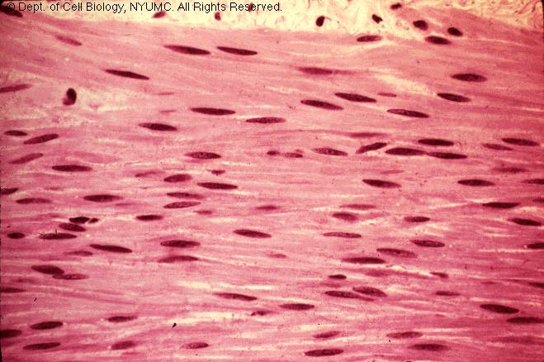
What this covers
Notes:
Cellular level =Microscopy : cilia , blood smear, muscle, bone (clockwise)

Slide 5
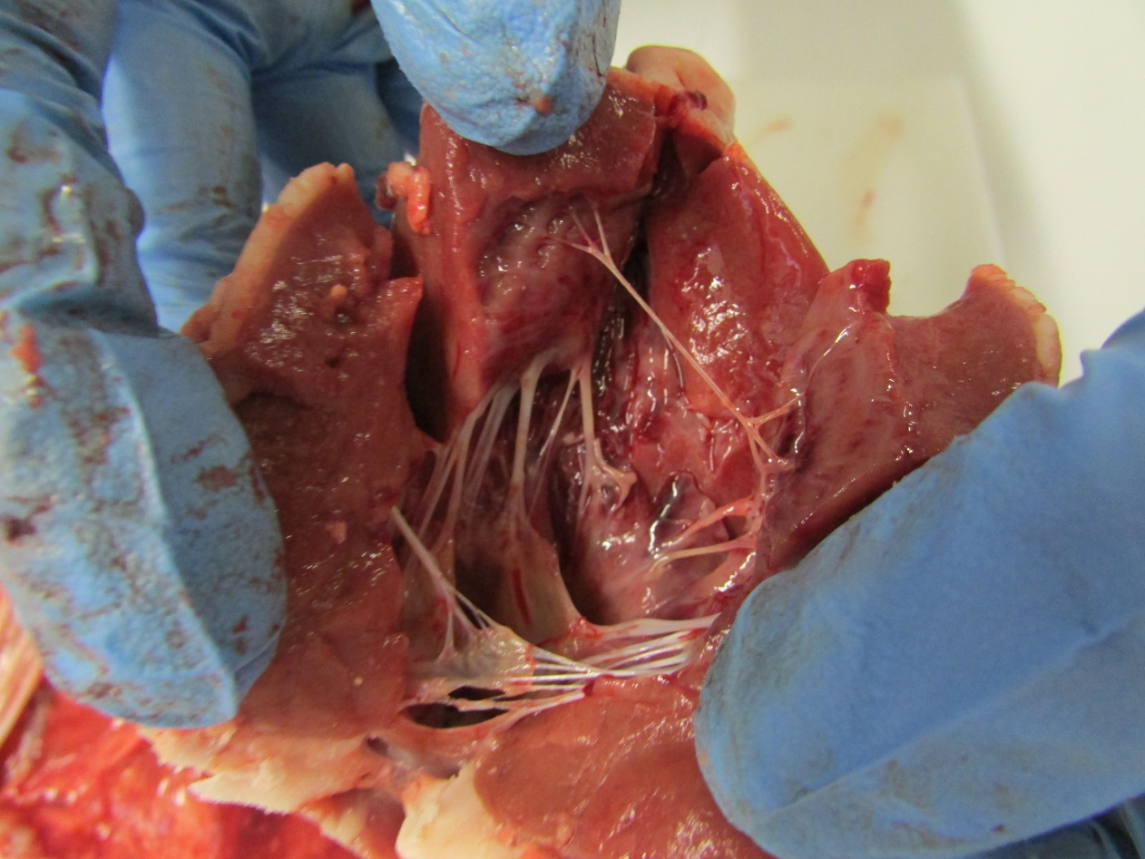
Notes:
Gross anatomy level = Dissection (heart)

Slide 6
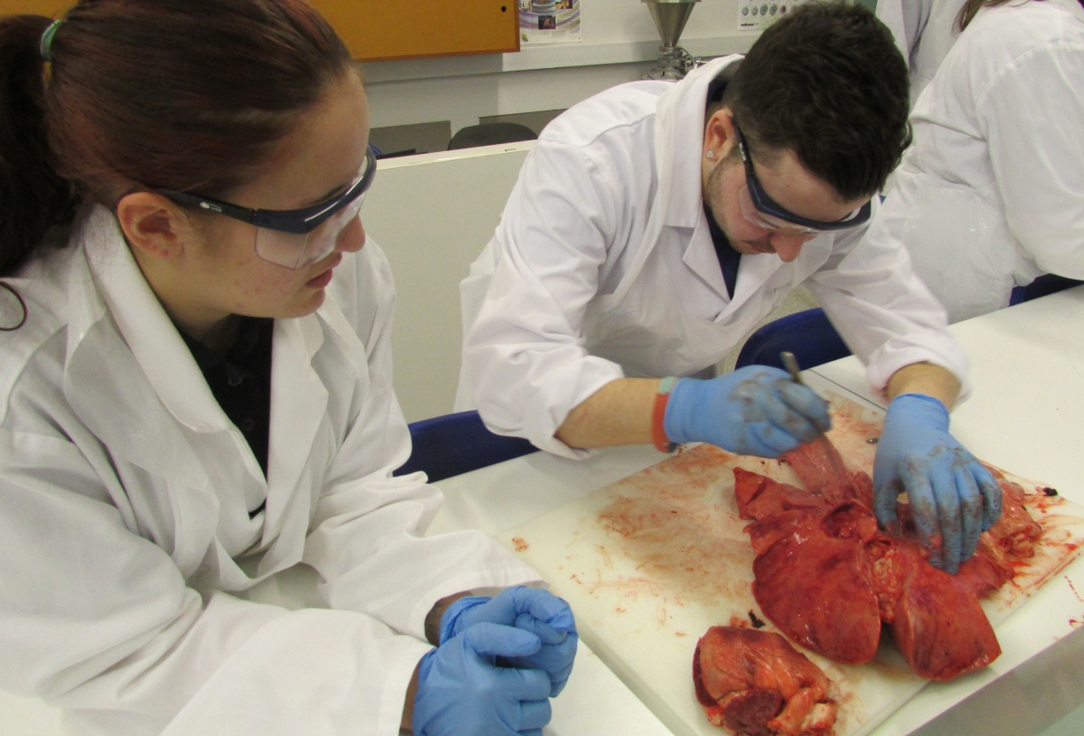
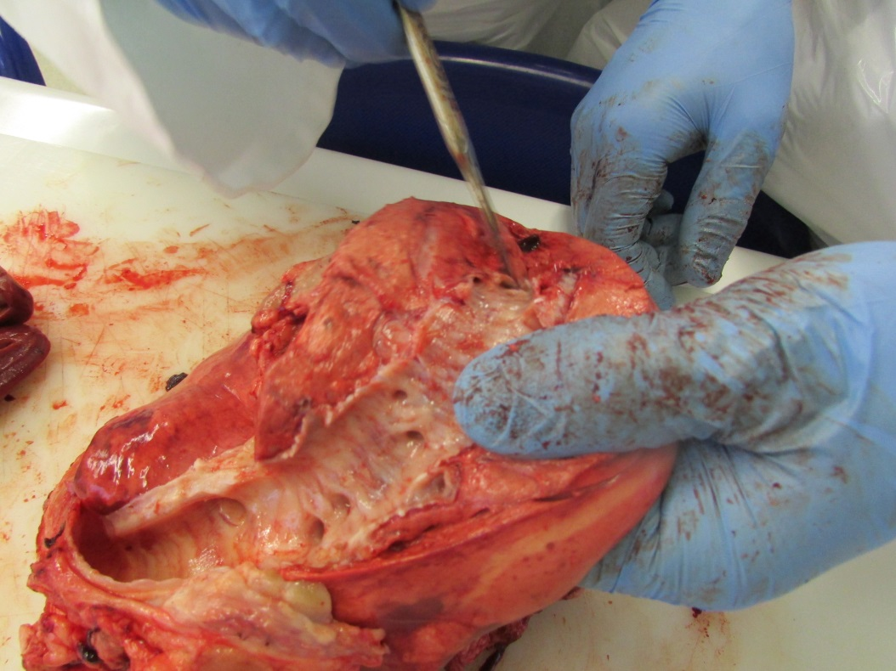
Notes:
Dissection (lungs and windpipe)

Slide 7
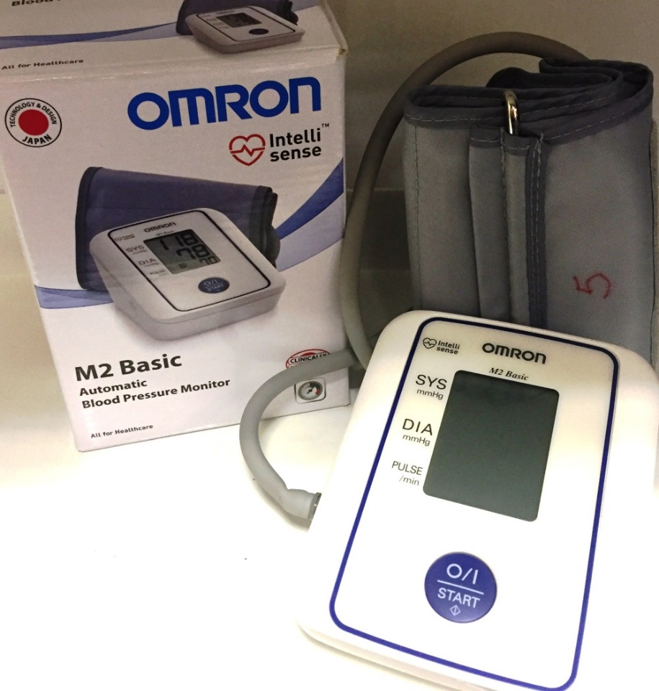
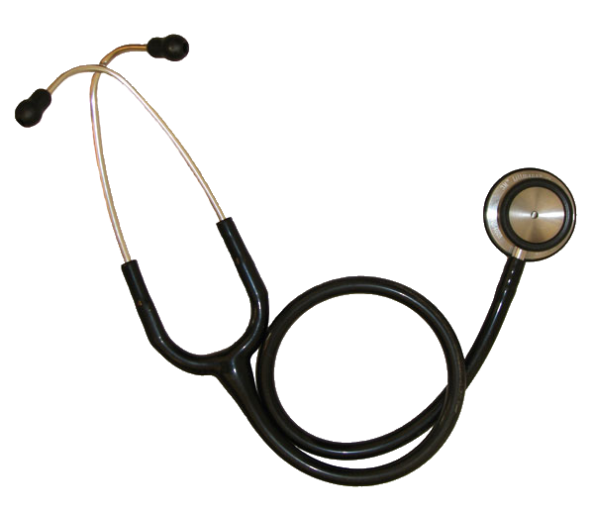
Measurements
Notes:
Heart rate and blood pressure

Slide 8
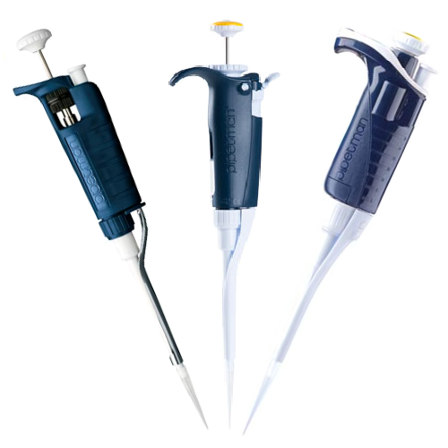
Notes:
Burettes and automatic pipettes

Slide 9
When systems don’t function properly
Notes:
Human Growth Hormone: under and over production

Slide 10
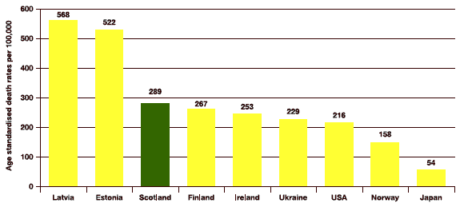
Working with data
Incidence of diabetes in Scotland 2014
Death rates from heart disease
Notes:
How to present data accurately: Top graph= label missing on Y axis/ Greater Glasgow larger so expect more. Bottom graph= better

Slide 11
Assessment
Theory test inc data handling (2 part closed book exam)
Practical work (checklist and laboratory report)
Notes:
60% pass mark in exams

