Slide 1
Women Into STEM
Session 2 - Customers & Market Research

Slide 2
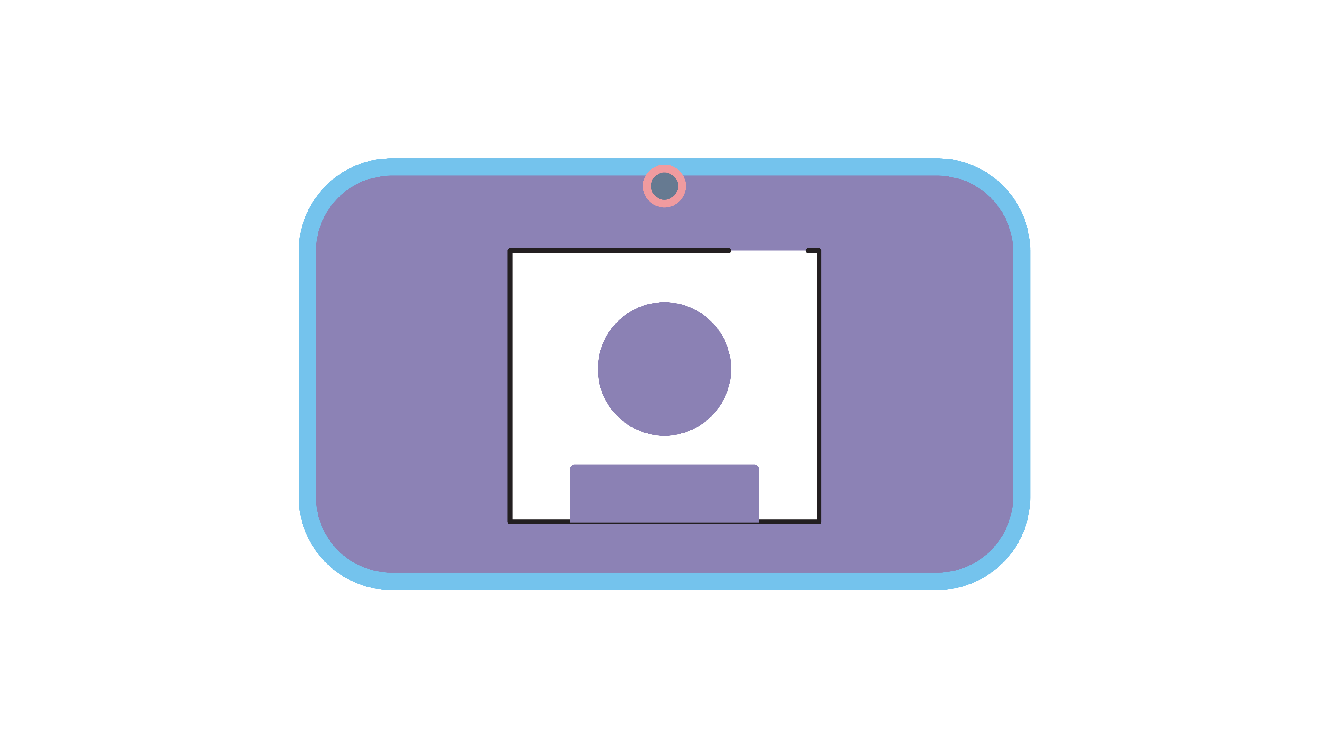
Teams Etiquette
Notes:
Introduction to functions of Zoom/Teams
Chat function
Raising hands
Unmute/mute

Slide 3
Today’s Session
 | We will take up to 55 minutes.
 | You will need a pen and paper.

Slide 4
Learning Objectives
You will be able to identify the Marketing Method being used by examining case studies.
You will be able to demonstrate an understanding of different customer groups.
You will know what a Customer Profile is.
You will understand the importance of Market Research and it’s methods.
.

Slide 5
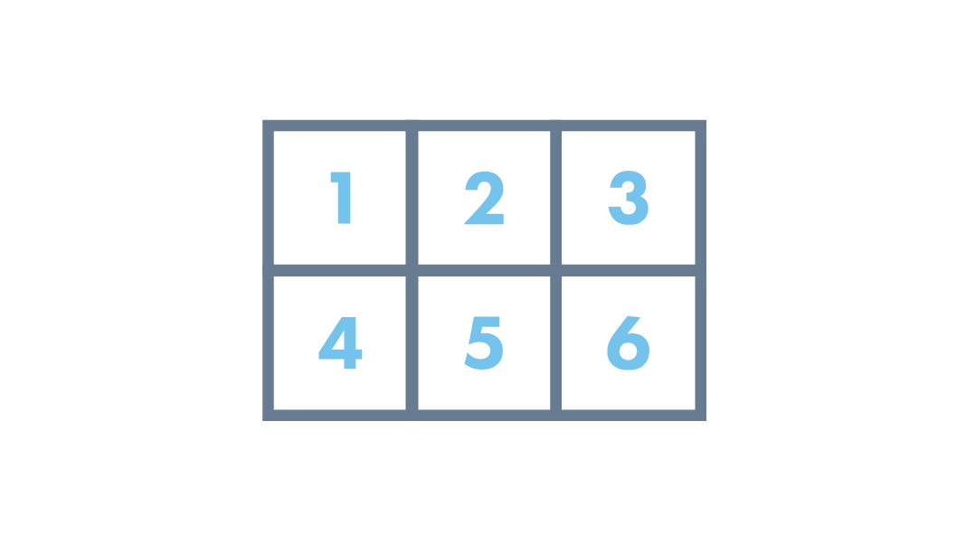
Today’s Topics
Recap of last week
Case Studies
Customer Groups
Customer Profiling
Market Research
Methods of Market Research
Notes:
KH Notes:
What is marketing?
Types of Marketing
The success and fails
Marketing plans
The Importance of branding
Setting the story – engaging the customer

Slide 6
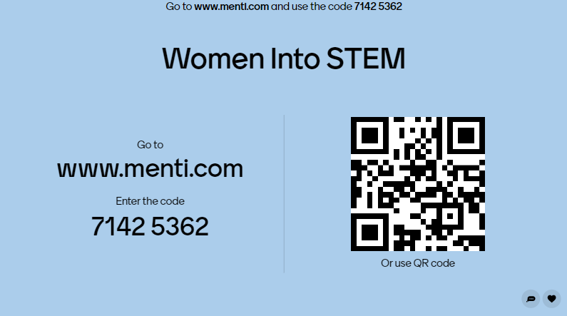
Recap of last week…

Slide 7
Marketing Methods
Word of mouth
Transactional marketing
Diversity marketing
Emotional marketing
Paid advertising
Cause marketing
Relationship marketing
Undercover marketing

Slide 8
Marketing Case Studies

Slide 10
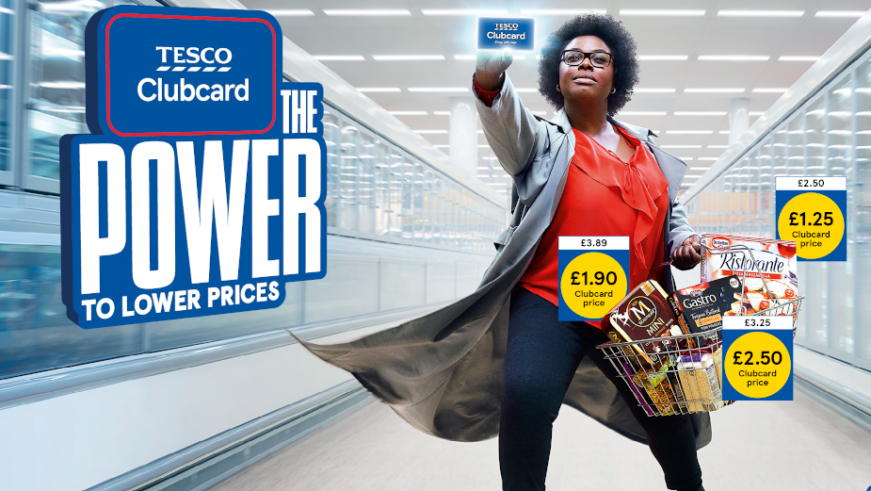
Case Studies
Tesco Clubcard:
“The Power to Lower Prices”
What does it do for customers?
What method of marketing does it use?
Notes:
Tesco Clubcard – The Power to Lower Prices

Slide 12
Case Studies
Always ‘Like A Girl’
What does the campaign do?​
​
How does it make you feel?

Slide 13
Marketing Fails
Starbucks
Pepsi

Slide 15
Customer Groups
Distinct group of people from the same generation whom have similar buying or consuming habits
You may have more than one customer group
Your customer groups may cross over and change as your ideas or business develops
Your customer may be different from your user
Notes:
Interactive** What is a customer group? **add in Menti slide**
Customer Groups are
Distinct group of people from the same generation whom have similar buying or consuming habits
You may have more than one customer group
Your customer groups may cross over and change as your ideas or business develops
Your customer may be different from your user

Slide 16
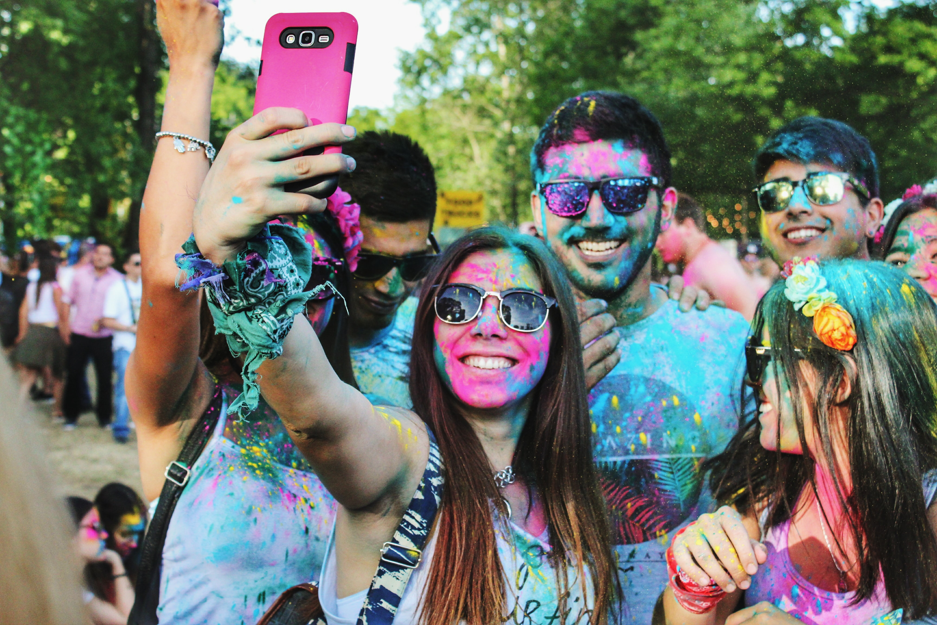
Gen Z: Born after 1997
Gen Y/Millennial: 1980 - 1994
Gen X: 1965 – 1979
Baby Boomers: 1945 – 1964
Grey Market: 1925 – 1945
Notes:
**Interactive – has anyone seen any of these before?**
Gen Z – 1995 – onwards – have been exposed to the internet and technology their whole life – perhaps less focused as they process info more quickly, better at multi-tasking, not bothered too much about price, value independence – have higher expectations, they expect brand loyalty
Gen Y/Millennial – 1980 – 1994 – entered workforce as economy crashed – largest group of entrepreneurs, social media savvy, online, reviews, ease of shopping, where to eat based on Instagram, hair stylists from facebook – focus on innovations, influenced by peers – negative assumptions – lazy, unhappy, entitled, narcissits,
Gen X – 1965 – 1980 – hybrids – grew up without online but have adapted, busy, juggling a lot – coupons, email marketing, invest in ethical brands
Gen Y
Baby Boomers – born 1946 – 1964 – up-sell/brand loyal/traditional sales
Silent/Grey Market
**Interactive - Which generation do you fall into?**
If using Zoom – using Annotation to tick which one audience falls into.
Gen Z – born after 1997 – born into diversity, digital natives, entrepreneurial, less-focused, socially aware and instantaneous
Gen Y/Millennial – 1980 – 1996 – champion diversity, optimistic and realistic, self inventive, multi-cultural, collaborative and confident
Gen X – 1965 – 1979 – accept diversity, pragmatic and practical, self-reliant, sceptical, independent and hard-working
Baby Boomers 1945 – 1964 - adapting to diversity, work-centric, desire quality, independent, goal orientated and strong leaders
Grey Market – 1925 – 1945 – adopting diversity, direct, honest, respectful of authority, loyal and disciplined

Slide 17
Discussion
Thinking about your campaign Identify the core customer group for the campaign Explain why you believe they are the core customer group Categorise any secondary groups you think may be customers and explain why
2
Notes:
Groups of 5 or 6
Festive Wreath Making Class
Women in Business Networking Event
Historic Castle Tour
University Open Day
Gin Tasting
Light Show – Edinburgh Zoo
National Heritage Trail Guided Walk
Cyber Security Workshop

Slide 18
Customer Needs
What are your customer needs?
Ease of access
Service
Quality
Style
Notes:
What is your customer needs?
Speed
Ease of access
Service
Quality
Style
You will need to understand:
Needs, wants, pains, demographics, interests, motivations

Slide 19
Customer Profile
Name: Louisa
Demographics
Age: 25
Gender: Female
Marital Status: Single
Occupation:
Recruitment Consultant
Income:
£25K
Education:
College
Behaviour:
Buys mainly online
Buys large quantities and often at lower prices
Influenced by peers & socials
Wants:
Quick turnaround of new styles/products
Quick delivery
Affordable trends
Pain Points:
Delivery charges
No new styles
Motivations:
Speed
Costs
Quirkiness
Channels:
Online
Social media – mainly Instagram
Notes:
Customer Profiling
Use Facebook example of building a customer profile – tell them our age, location, interests, likes, wants etc.
customer Profiling helps advertisers

Slide 20
Homework Task
Create your own Customer Profile
What age is your customer?
What gender do they identify as?
Where would they see the most ads?
How are they going to be most influenced?
How often do they buy?
Where do they live?
What are their interests?
What socials do they use?
Notes:
Create Your Own Customer Profile
Can use customer sections from Lynn’s marketing

Slide 21
Market Research
Why is it important?

Slide 22
Why Market Research?
Gain customer feedback
Predict market trends
Identify business opportunities
Awareness of competitors
Market Segmentation
Customer communication and engagement
Notes:
Prevailing trends in the Market.
Market Segmentation.
Market information on product prices.
Analysis of the business strength, weakness, opportunities as well as threat.
Market research analysis on products, consumer accounts, and competitor.
Effective tapping of the prevailing market opportunities by identifying and using them to the best.
In encouraging a healthy communication with consumers by knowing their preferences, likes, and dislikes.
In taking immediate and timely actions in certain areas of the business and thus help to decrease the business risk.
To study the market trends and set up newer trends in the market according to consumer preferences and needs.
Identify the existing problems, work on them taking into consideration the opinion voiced by the consumers especially on products that are in the different stages of development.

Slide 23
Market Research
Primary Data: Information gained directly by yourself from your own research
Secondary Data: Information collected by someone else
Qualitative Data: Information that can be observed and discussed however, cannot be measured
Quantitative Data: Information that is numerical and can be compared e.g. percentages and statistics
Notes:
Market Research
**Interactive – why do we need market research?**
Market Research is gathering thoughts, feelings and feedback about customers or potential customers needs, wants and preferences.
There are different types of Market Research you can gather and it’s a good idea to source different types of information so you have a full picture.
Primary & Secondary Data:
Primary Data: Information gained directly by yourself from your own research
Secondary Data: Information collected by someone else
Qualitative & Quantitative Data:
Qualitative Data: Information that can be observed and discussed however, cannot be measured
Quantitative Data: Information that is numerical and can be compared e.g. percentages and statistics

Slide 24
Methods of Market Research
Surveys
Focus Groups
Interviews
Field Trials
Observation
Tools:
Survey Monkey
Mentimeter
Google Forms
Notes:
Methods of Market Research
Surveys
Focus Groups
Interviews
Field Trials
Observation
Start thinking of questions you might ask, what you want to find out, how you will measure this

Slide 25
Market Research Questions
Open Questions
Relevant
Constructive
Probing
Example:
Did you like the product?
What did you like about the product?

Slide 26
Round - Up
Customer Groups
Buying Motivation
Customer Profiling
Buying Behaviour
Customer Relations
Market Research
Methods of Market Research

Slide 28
Get In Touch:
Morven McColl
Programme Executive – Bridge 2 Business
Morven.McColl@yes.org.uk
Morven McColl (@morven_mccoll) / Twitter
Morven McColl | LinkedIn
Notes:
Bridge 2 Business Student Support Feeling inspired and want to have a chat with Bridge 2 Business? Why not get in touch and schedule a 1-2-1 with us! In your 1-2-1 we’ll discuss your idea(s) or any of the initititaives you are interested in, and what support or funding could be best suited for you, as well as what other support is available to test your ideas, and get them off the ground. Some support from other external partners have age and industry restrictions – this is something we will discuss at your 1-2-1. We can help you develop your business ideas further through basic business planning to help you kick started!

Slide 29
Any Questions?

