Slide 1
Women Into STEM
Session 3 - Market Research & Pitching

Slide 2
Teams Etiquette
Notes:
Introduction to functions of Zoom/Teams
Chat function
Raising hands
Unmute/mute

Slide 3
Today’s Session
 | We will take up to 55 minutes.
 | You will need a pen and paper.

Slide 4
Learning Objectives
You will understand what a Pitch is and when you may need one.
You will be able to understand different objectives, audiences and structures of a pitch.
You will have knowledge of different styles of Pitch.

Slide 5
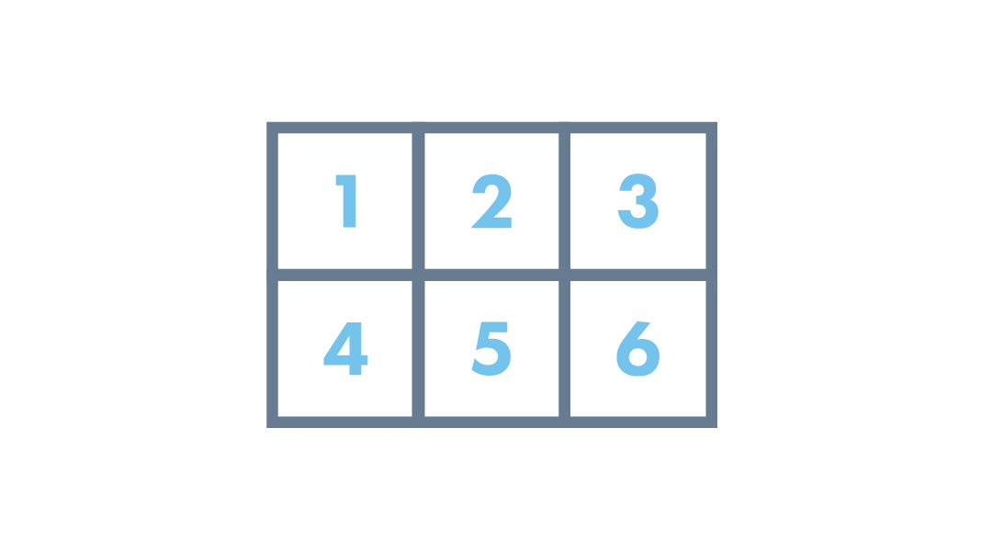
Today’s Topics
Menti
Kirstin – Skills Development Scotland
Audiences
Types of Pitch
Pitching Styles
Pitch Structure
Notes:
KH Notes:
What is marketing?
Types of Marketing
The success and fails
Marketing plans
The Importance of branding
Setting the story – engaging the customer

Slide 7
Kirstin Gray
Notes:
Opening Slide
Instructions for presenter:
When preparing for this presentation, please sign into the YES menti meter account and open the “Social Enterprise in Scotland” presentation slides that go with this PowerPoint and make a note of the menti voting code that is generated. You will need to give this number to your audience so that they can answer questions.
If you cannot access menti meter then you can take audience answers in the chat function of Teams.

Slide 8
Marketing Methods
Word of mouth
Transactional marketing
Diversity marketing
Emotional marketing
Paid advertising
Cause marketing
Relationship marketing
Undercover marketing

Slide 9
Pitching
What is a Pitch?
A presentation to share plans, ideas and thoughts usually for a business proposition or project.
When might we need to do a Pitch?
At Work
School/college
Starting Up
Personal Project
Notes:
Question – how confident do we all feel public speaking or if I asked you to create a Pitch?

Slide 10
Objective
Your objective is your “why” or your “ask”.
It’s important to have a clear call to action and “ask” within our pitch so that our audience has a clear understanding and isn’t confused about the “ask”.
What might some objectives be?
Notes:
Objectives:
For money
For expertise
Gain customers
Collaboration
Partnership

Slide 11
Audience
Different audiences will require different levels of information and different styles of pitch.
Investors
Funders
Customers
Partners
Collaborators

Slide 12
Type of Pitch
Elevator A quick 1 minute pitch which interests and entices your audience in which could be spoken in a short Elevator journey. | Investment A structured and formal pitch where the “ask” is generally money and expertise which will include facts and figures. Often 5-10 minutes. | Competition Generally structured and formal where there is a “prize” at the end and the pitch is tailored around this prize. Can differ in length Often 3 – 5 minutes. | Twitter Short, snappy and could be summed up within a sentence. Hence the Twitter label.
Notes:
Elevator
Investment
Competition
Twitter

Slide 13
Pitching Styles
Structured | Hard Hitting Facts | Emotional | Informal | Story-Led
Notes:
Structured
Hard hitting facts
Emotional
Informal
Story-led

Slide 14
Pitching Structure
Hook To entice in the audience and grab their attention.
Problem Explain the importance of the issue or cause.
Solution The idea explain USPs and it’s importance.
Market The customers, the size of the market and the scale of reach.
Competitors Shows awareness of the market area, needs/wants and differentiation.
Opportunity Where the idea can grow to, what is it’s potential.
Ask A clear, concise ask that there is for the audience.

Slide 15
Hook
Question led
“When was the last time you recycled?”
Statement led
“More than 800,000 people in the United States die from cardiovascular disease each year!”
Personal Story
“The last time I visited an airport was when I was 25…”

Slide 16
Hook
Here are different techniques used as pitch openers:
Describe the problem, followed by your solution
“I noticed homelessness was increasing, so I set up my charity to..”
Hard hitting facts or stats
“Coronary Heart Disease remains the number 1 killer in the UK…we have introduced our App to help improve healthier lifestyles…”
Open with a question
“When was the last time you recycled? Our services aim to educate and inspire less waste…”

Slide 17
How to improve your Pitching
Body language and tone of voice
Be yourself
Consider your audience
Use visual aids
Do what works for you
Allow time and create opportunity for questions
80% delivery 20% content

Slide 18
Round - Up
Customer Groups
Buying Motivation
Customer Profiling
Buying Behaviour
Customer Relations
Market Research
Methods of Market Research

Slide 19
Homework Task
Create your own Customer Profile
What age is your customer?
What gender do they identify as?
Where would they see the most ads?
How are they going to be most influenced?
How often do they buy?
Where do they live?
What are their interests?
What socials do they use?
Notes:
Create Your Own Customer Profile
Can use customer sections from Lynn’s marketing

Slide 20
Get In Touch:
Morven McColl
Programme Executive – Bridge 2 Business
Morven.McColl@yes.org.uk
Morven McColl (@morven_mccoll) / Twitter
Morven McColl | LinkedIn
Notes:
Bridge 2 Business Student Support Feeling inspired and want to have a chat with Bridge 2 Business? Why not get in touch and schedule a 1-2-1 with us! In your 1-2-1 we’ll discuss your idea(s) or any of the initititaives you are interested in, and what support or funding could be best suited for you, as well as what other support is available to test your ideas, and get them off the ground. Some support from other external partners have age and industry restrictions – this is something we will discuss at your 1-2-1. We can help you develop your business ideas further through basic business planning to help you kick started!

Slide 22
Any Questions?

